Slide 1
Chapter 19
An introduction to database programming

Slide 2
Objectives
Knowledge
Describe the hardware components of a typical multi-user system.
Describe the software components of a typical multi-user database application.
Explain how a table in a relational database is organized.
Explain how the tables in a relational database are related.
Describe the use of these SQL statements: SELECT, INSERT, UPDATE, and DELETE.

Slide 3
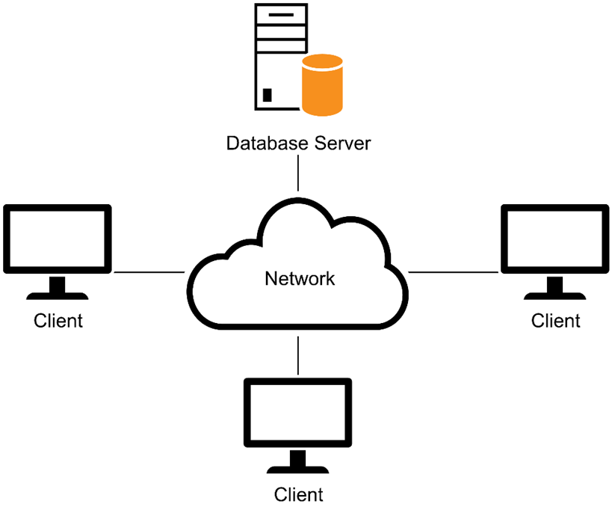
A simple client/server system

Slide 4
The three hardware components of a client/server system
The clients are the PCs, Macintoshes, or workstations of the system.
The server is a computer that stores the files and databases of the system and provides services to the clients. When it stores databases, it’s often referred to as a database server.
The network consists of the cabling, communication lines, and other components that connect the clients and the servers of the system.

Slide 5
Client/server system implementations
In a simple client/server system, the server is typically a high-powered PC that communicates with the clients over a local area network (LAN).
The server can also be a midrange system, like an IBM Power System or a Unix system, or it can be a mainframe system. Then, special hardware and software components are required to make it possible for the clients to communicate with the midrange and mainframe systems.
A client/server system can also consist of one or more PC-based systems, one or more midrange systems, and a mainframe system in dispersed geographical locations. This type of system is commonly referred to as an enterprise system.
Individual systems and LANs can be connected and share data over larger private networks, such as a wide area network (WAN) or a public network like the Internet.

Slide 6
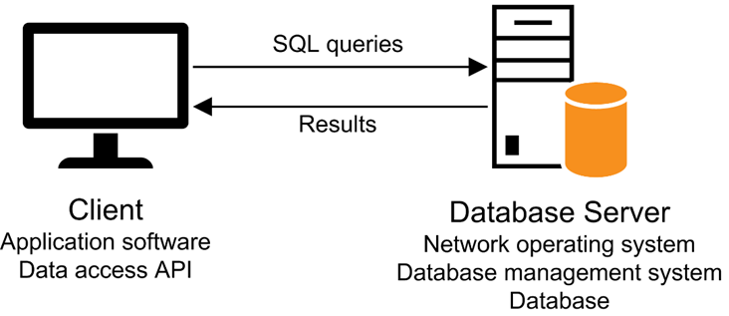
Client software, server software, and the SQL interface

Slide 7
Server software
To manage the network, the server runs a network operating system such as Windows Server.
To store and manage the databases of the client/server system, each server requires a database management system (DBMS) such as Microsoft SQL Server.
The processing that’s done by the DBMS is typically referred to as back-end processing, and the database server is referred to as the back end.

Slide 8
Client software
The application software does the work that the user wants to do. This type of software can be purchased or developed.
The data access API (application programming interface) provides the interface between the application and the DBMS. Microsoft’s data access API is ADO.NET, which is a part of .NET.
The processing that’s done by the client software is typically referred to as front-end processing, and the client is typically referred to as the front end.

Slide 9
The SQL interface
The application software communicates with the DBMS by sending SQL queries through the data access API. When the DBMS receives a query, it provides a service like returning the requested data (the query results) to the client.
SQL, which stands for Structured Query Language, is the standard language for working with a relational database.

Slide 10
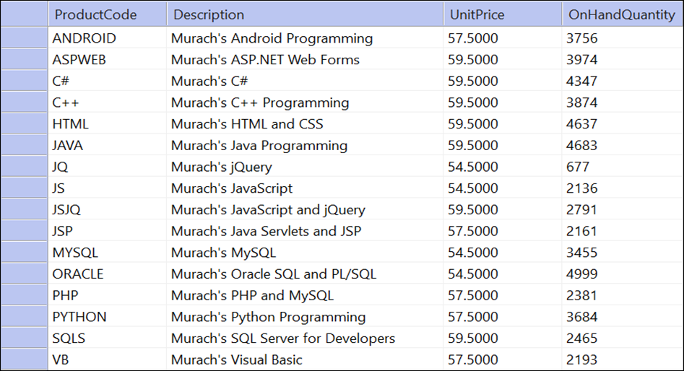
The Products table in the MMABooks database

Slide 11
How a table is organized
A relational database uses tables to store and manipulate data.
Each table consists of one or more records, or rows, that contain the data for a single entry.
Each row contains one or more fields, or columns, with each column representing a single item of data.
Most tables contain a primary key that uniquely identifies each row in the table.
Some database management systems let you define one or more non-primary keys. In SQL Server, these keys are called unique keys, and they’re implemented using unique key constraints.
A table can also be defined with one or more indexes. An index provides an efficient way to access data from a table based on the values in specific columns. An index is automatically created for a table’s primary and non-primary keys.

Slide 12
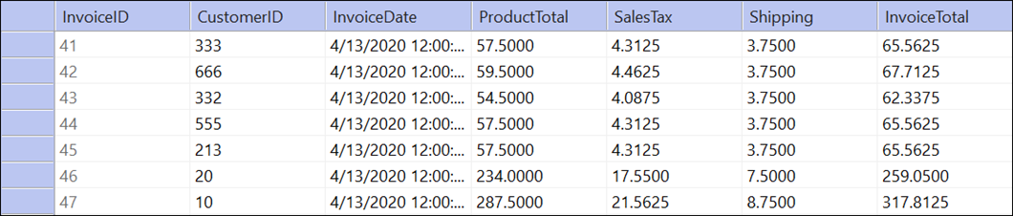
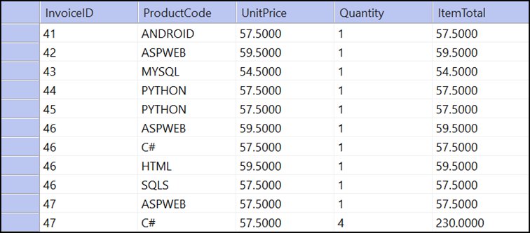
Two related tables: Invoices and InvoiceLineItems

Slide 13
How the tables in a database are related
The tables in a relational database are related to each other through their key columns. A column that identifies a related row in another table is called a foreign key.
Usually, a foreign key corresponds to the primary key in the related table. In SQL Server, however, a foreign key can also correspond to a unique key in the related table.
When two tables are related via a foreign key, the table with the foreign key is referred to as the foreign key table and the table with the primary key is referred to as the primary key table.
The relationships between the tables in a database correspond to the relationships between the entities they represent. The most common type of relationship is a one-to-many relationship. A table can also have a one-to-one relationship or a many-to-many relationship with another table.

Slide 14
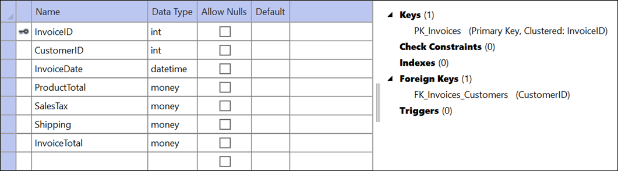
The Server Explorer design view window for the Invoices table

Slide 15
Common SQL Server data types
bit
char, varchar, nchar, nvarchar
datetime, smalldatetime
decimal, numeric
float, real
bigint, int, smallint, tinyint
money, smallmoney

Slide 16
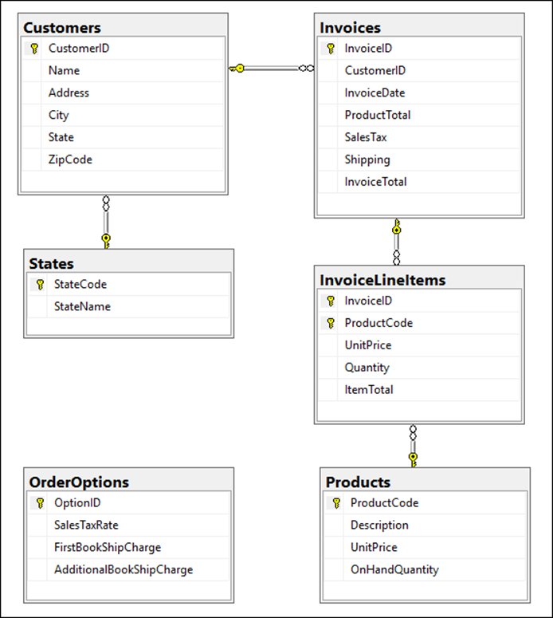
The tables that make up the MMABooks database

Slide 17
Simplified syntax of the SELECT statement
SELECT column-1 [, column-2]...
FROM table-1
[WHERE selection-criteria]
[ORDER BY column-1 [ASC|DESC] [, column-2 [ASC|DESC]]...]

Slide 18
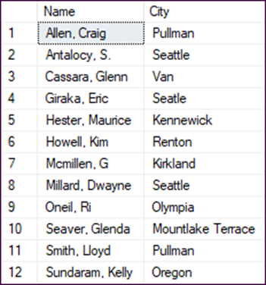
A SELECT statement that retrieves and sorts selected columns and rows from the Customers table
SELECT Name, City
FROM Customers
WHERE State = 'WA'
ORDER BY Name
The result set

Slide 19
How to query a single table
The result of a SELECT statement is a result table, or result set.
The SELECT clause lists the columns to be included in the result set. This list can include calculated columns that are calculated from other columns.
The FROM clause names the table the data will be retrieved from.
The WHERE clause provides a condition that specifies which rows should be retrieved. To retrieve all rows from a table, omit the WHERE clause.
The ORDER BY clause lists the columns that the results are sorted by and indicates whether each column is sorted in ascending or descending sequence.
To select all of the columns in a table, you can code an asterisk (*) in place of the column names:
SELECT * FROM Customers

Slide 20
The syntax of the SELECT statement for joining two tables
SELECT column-list
FROM table-1 [AS alias-1]
[INNER] JOIN table-2 [AS alias-2]
ON table-1.column-1 {=|<|>|<=|>=|<>} table-2.column-2
[WHERE selection-criteria]
[ORDER BY column-list]

Slide 21
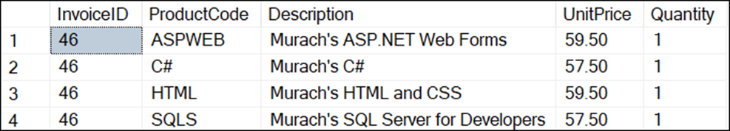
A SELECT statement that joins data from the InvoiceLineItems and Products tables
SELECT InvoiceLineItems.InvoiceID, InvoiceLineItems.ProductCode, Products.Description,
InvoiceLineItems.UnitPrice, InvoiceLineItems.Quantity FROM InvoiceLineItems INNER JOIN Products ON InvoiceLineItems.ProductCode =
Products.ProductCode WHERE InvoiceLineItems.InvoiceID = 46
The result set defined by the SELECT statement

Slide 22
A SELECT statement that uses aliases for table names
SELECT li.InvoiceID, li.ProductCode, p.Description, li.UnitPrice, li.Quantity FROM InvoiceLineItems AS li INNER JOIN Products AS p ON li.ProductCode = p.ProductCode WHERE li.InvoiceID = 46

Slide 23
How to join data from two or more tables
A join lets you combine data from two or more tables into a single result set.
The most common type of join is an inner join. This type of join returns rows from both tables only if their related columns match.
You can make your SQL statements more readable by using aliases for table names.

Slide 24
How to add a single row
The syntax of the INSERT statement for adding a single row
INSERT [INTO] table-name [(column-list)]
VALUES (value-list)
A statement that adds a single row to the Products table
INSERT INTO Products (ProductCode, Description,
UnitPrice, OnHandQuantity)
VALUES ('C#', 'Murach''s C#', 59.50, 3000)

Slide 25
How to update rows
The syntax of the UPDATE statement
UPDATE table-name
SET column-name-1 = expression-1
[, column-name-2 = expression-2]...
[WHERE selection-criteria]
A statement that updates the UnitPrice column for a specified product
UPDATE Products
SET UnitPrice = 54.00
WHERE ProductCode = 'MYSQL'

Slide 26
How to delete rows
The syntax of the DELETE statement
DELETE [FROM] table-name
[WHERE selection-criteria]
A statement that deletes a specified customer
DELETE FROM Customers
WHERE CustomerID = 558

Slide 27
Objectives
Knowledge
Describe the hardware components of a typical multi-user system.
Describe the software components of a typical multi-user database application.
Explain how a table in a relational database is organized.
Explain how the tables in a relational database are related.
Describe the use of these SQL statements: SELECT, INSERT, UPDATE, and DELETE.

